Slide 1

Digital Logic Design Introductory Concepts Fall-2025
Instructor: Muhammad Ismail Qureshi
Computer Science Department
Sukkur IBA University
Kandhkot Campus

Slide 2
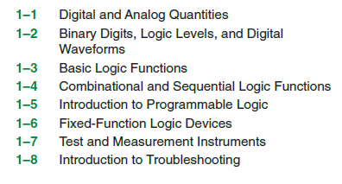
OUTLINE

Slide 3
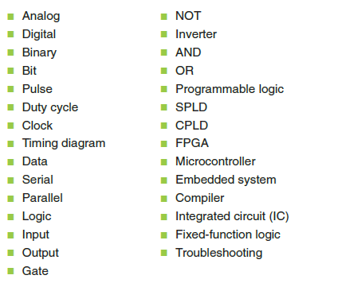
Key Terms

Slide 4
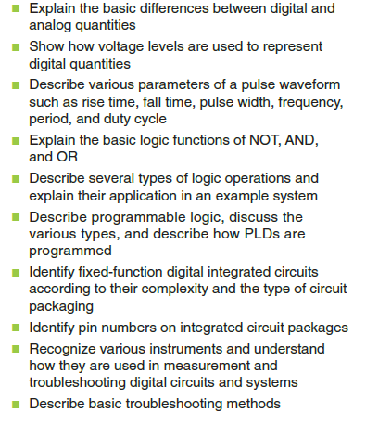
Objectives

Slide 5
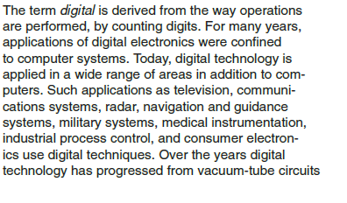
Introduction of the Course

Slide 6
Before Diving into the DLD exploring Electron and Electronics
Electronics is a branch of physics and engineering
deals with the study and application of electron behavior, flow, and control
particularly in circuits and devices that manipulate electrical currents
encompasses the design, construction, and operation of devices that use electricity to control, communicate, and process information.
Electronics focuses on the movement of electrons
how they can be harnessed to perform specific tasks
such as powering devices, transmitting signals, or processing information.

Slide 7
Before Diving into the DLD exploring Electronics
Key Components
transistors, diodes, and integrated circuits
to control and amplify electrical currents.
Applications
computers, smartphones, televisions, and countless other devices that shape our daily lives.
Relationship to Physics and Engineering
Electronics is a subfield of physics, specifically focusing on the behavior of electrons, and also a field of electrical engineering, which applies these principles to design and build electronic systems and devices.

Slide 8
Before Diving into the DLD exploring Electronics
a branch of Physics that deals with the theory and use of devices in which the electrons travel through a vacuum, gas, or a semiconductor medium
the branch of science and technology ,which deals with the electrical circuits and equipment like diodes, transistors and relays
the study of how to control flow of electrons
electronic components include diodes, transistors, and integrated circuits

Slide 9
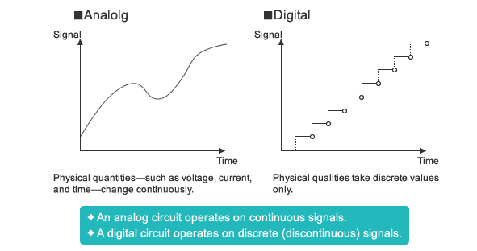
Analog Vs Digital

Slide 10
Analog Quantities Electronic circuits can be divided into two broad categories, digital and analog.
analog electronics involves quantities with continuous values.
interfacing between analog and digital is important
An analog* quantity is one having continuous values
Most things that can be measured quantitatively occur in nature in analog form.
air temperature, time, pressure, distance, and sound, all the infinite values in between
continuous variables that can take on any value within a given range
Analog quantities change smoothly and continuously
There are no sudden jumps or gaps in the values
data is transferred in a wave
analog computer are oscilloscope, television, autopilot, telephone lines, speedometer

Slide 11
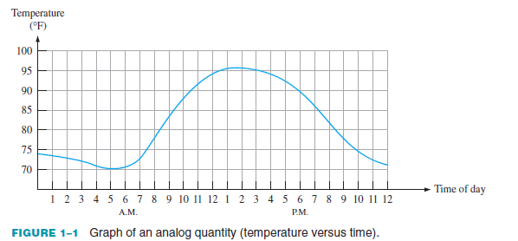
Analog Quantities

Slide 12
Digital Quantities
Digital electronics involves quantities with discrete values
A digital quantity is one having a discrete set of values
Rather than graphing the temperature on a continuous basis
you just take a temperature reading every hour
Now you have sampled values representing the temperature at discrete points in time (every hour) over a 24-hour period, as indicated in Figure 1–2.
effectively converted an analog quantity to a form that can now be digitized by representing each sampled value by a digital code
set of defined states
often using binary code (0s and 1s) to represent information
Key Characteristics of Digital Quantities:
Discrete Values:
limited set of specific, separate values

Slide 13
Digital Quantities
Binary Representation:
Digital systems commonly use binary code (0 and 1) to represent these discrete values.
Easier Processing and Storage:
easier to process, store, and transmit due to its discrete nature and the ability to use digital circuits.
Reduced Noise and Distortion:
Digital signals are less affected by noise and distortion compared to analog signals, leading to more reliable information transfer.
Examples of Digital Quantities:
Digital clocks: Show time using discrete numbers (e.g., 10:30 AM).
Digital music: Audio is stored as a series of discrete values representing the sound wave.
Digital cameras: Capture images using a grid of discrete pixels.
Computers and calculators: Process information using binary code.
Switches (on/off): Representing two distinct states.
Counters: Counting discrete items or events.
Pulse-width modulation (PWM): Used in various applications to control power and other parameters.

Slide 14
Digital Quantities
less noise, distortion, and interference
Digital circuits can be reproduced easily in mass quantities at comparatively low costs
Digital signal processing is more flexible because DSP operations can be altered using digitally programmable systems
Computers:
Digital signals are fundamental to how computers process and store information. Every keystroke on a keyboard, every mouse click, and every operation within the CPU relies on digital signals.
Digital Communication:
The internet, smartphones, and other digital communication systems use digital signals to transmit data, voice, and video.
Consumer Electronics:
Digital signals are used in devices like smartphones, digital cameras, smart TVs, MP3 players, and more, enabling them to process and display information accurately.

Slide 15
Digital Quantities
Control Systems:
In industrial automation, digital signals are used to control various processes and devices, such as in programmable logic controllers (PLCs).
Audio and Video:
Digital audio (like MP3s) and digital video (like MP4s) are common examples of how digital signals are used to represent and transmit media.
Microcontrollers and Processors:
Digital signals are used extensively in the communication and processing within microcontrollers and processors in various electronic devices.
In essence, digital signals are the foundation of modern technology, enabling the accurate and efficient processing and transmission of information in a wide range of applications.

Slide 16
Digital Quantities
Disadvantage of Digital Signals
Develop quantization and round-off errors
Systems and processing is more complex
A higher bandwidth is required for data communication in comparison to analog transmission of an equivalent information
Digital systems and processing are typically more complex.
digital data can be processed and transmitted more efficiently and reliably than analog data.
great advantage when storage is necessary
music when converted to digital form can be stored more compactly and reproduced
with greater accuracy and clarity than is possible when it is in analog form.
Noise (unwanted
voltage fluctuations) does not affect digital data nearly as much as it does analog signals.

Slide 17
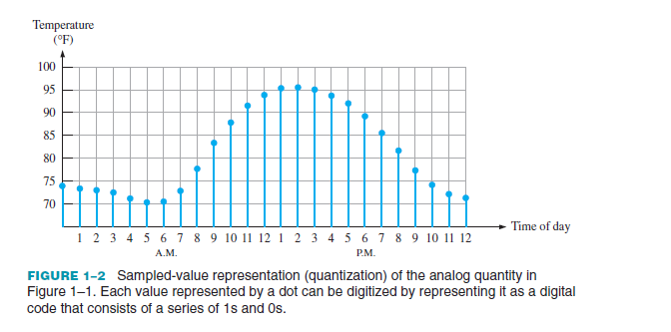
Digital Quantities

Slide 18
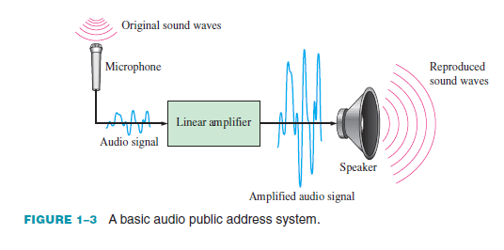
An Analog System
A public address system, used to amplify sound so that it can be heard by a large audience, is one simple example of an application of analog electronics.

Slide 19
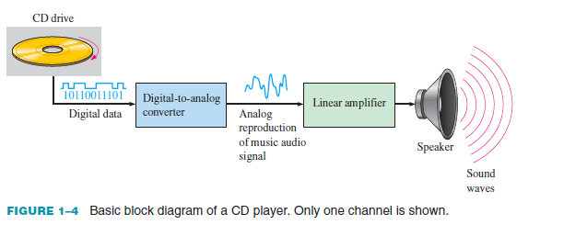
A System Using Digital and Analog Methods

Slide 20
Mechatronics
Both digital and analog electronics are used in the control of various mechanical systems.
The interdisciplinary field that comprises both mechanical and electronic components is known as mechatronics.
Mechatronic systems are found in homes, industry, and transportation.
Most home appliances consist of both mechanical and electronic components.
Electronics controls the operation of a washing machine in terms of water flow, temperature, and type of cycle.
Manufacturing industries rely heavily on mechatronics for process control and assembly.

Slide 21
Mechatronics
In automotive and other types of manufacturing, robotic arms perform precision welding, painting, and other functions on the assembly line.
Automobiles themselves are mechatronic machines
a digital computer controls functions such as braking, engine parameters, fuel flow, safety features, and monitoring.

Slide 22
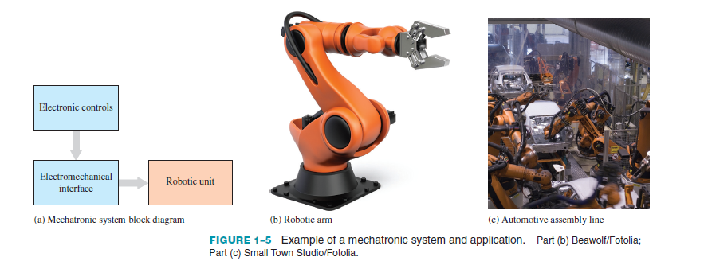
Mechatronics

Slide 23
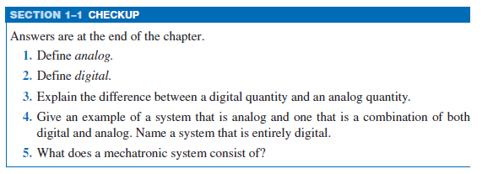
Assignment #1

Slide 24
1–2 Binary Digits, Logic Levels, and Digital Waveforms

Slide 25
Digital electronics
circuits and systems
two possible states.
represented by two different voltage levels
A HIGH and a LOW
The two states can also be represented by current levels, bits and bumps on a CD or DVD, etc.
In digital systems such as computers
combinations of the two states
called codes
Are used to represent numbers, symbols, alphabetic characters, and other types of information.

Slide 26
Digital electronics
The two-state number system is called binary
its two digits are 0 and 1
A binary digit is called a bit.

Slide 27
Binary Digits
Each of the two digits in the binary system, 1 and 0, is called a bit
which is a contraction of the words binary digit (b_it)
Generally, 1 is represented by the higher voltage, which we will refer to as a HIGH
0
lower voltage level
positive logic
Negative logic is reverse
Another system in which a 1 is represented by a LOW and a 0 is represented by a HIGH is called negative logic.
Groups of bits (combinations of 1s and 0s), called codes
used to represent numbers, letters, symbols, instructions, and anything else required in a given application.

Slide 28
Logic Levels
The voltages used to represent a 1 and a 0 are called logic levels.
a HIGH can be any voltage between a specified minimum value and a specified maximum value.
Likewise, a LOW can be any voltage between a specified minimum and a specified maximum.
There can be no overlap between the accepted range of HIGH levels and the accepted range of LOW levels.
the HIGH input values for a certain type of digital circuit technology called CMOS may range from 2 V to 3.3 V and
the LOW input values may range from 0 V to 0.8 V.
If a voltage of 2.5 V is applied, the circuit will accept it as a HIGH or binary 1.
a voltage of 0.5 V
accept it as a LOW or binary 0

Slide 29
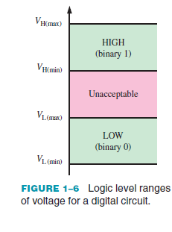
Logic Levels

Slide 30
Digital Waveforms
Digital waveforms consist of voltage levels that are changing back and forth between the HIGH and LOW levels or states
positive-going pulse
normally LOW level to its HIGH level and then back to its LOW level
negative-going pulse
in Figure 1–7(b) is generated when the voltage goes from its normally HIGH level to its LOW level and back to its HIGH level.
A digital waveform is made up of a series of pulses.

Slide 31
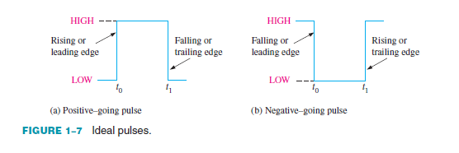
Digital Waveforms

Slide 32
The Pulse
a pulse has two edges
a leading edge that occurs first at time t0
a trailing edge that occurs last at time t1
For a positive-going pulse
the leading edgeis a rising edge
the trailing edge is a falling edge

Slide 33
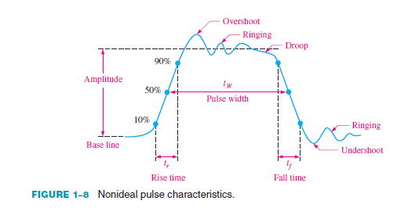
nonideal pulse

Slide 34
nonideal pulse
The overshoot and ringing
sometimes produced by stray inductive and capacitive effects.
The droop
caused by stray capacitive and circuit resistance
Forming an RC circuit with a low time constant

Slide 35
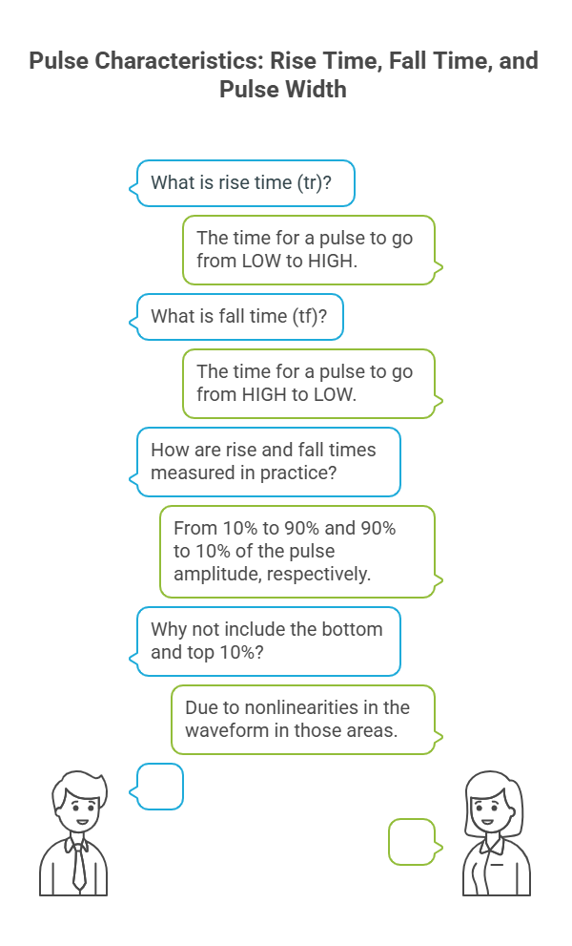
nonideal pulse

Slide 36
Waveform Characteristics
series of pulses, sometimes called pulse trains
classified as either periodic or nonperiodic
a fixed interval, called a period (T)
frequency ( f ) is the rate at which it repeats itself and is measured in hertz (Hz).
The frequency ( f ) of a pulse (digital) waveform is the reciprocal of the period.

Slide 37


Waveform Characteristics
An important characteristic of a periodic digital waveform is its duty cycle
ratio of the pulse width (tW) to the period (T )

Slide 38
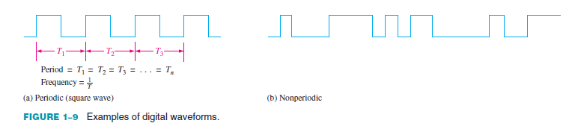
Waveform Characteristics

Slide 39
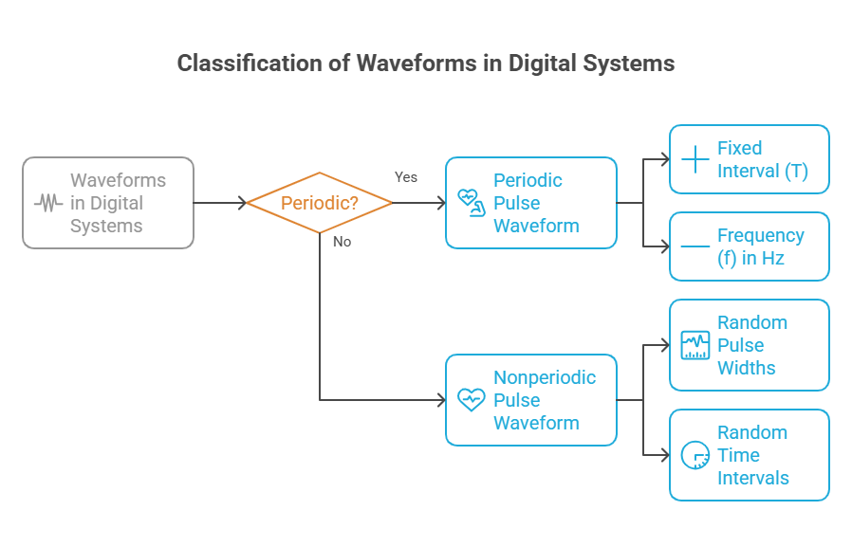
Waveform Characteristics

Slide 40
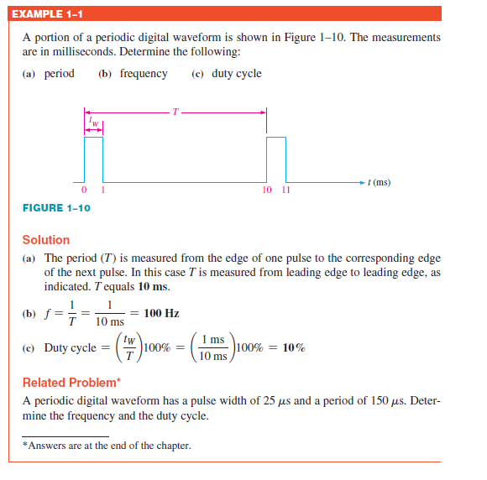
Numerical

Slide 41
A Digital Waveform Carries Binary Information
Binary information
handled by digital systems
appears as waveforms
that represent sequences of bits
When the waveform is HIGH,
a binary 1 is present
when the waveform is LOW,
a binary 0 is present
Each bit in a sequence occupies a defined time interval
Called a bit time.

Slide 42
A Digital Waveform Carries Binary Information
The Clock
In digital systems
all waveforms are synchronized with a basic
timing waveform called
the clock.
The clock is a periodic waveform
in which each interval between pulses (the period)
equals the time for one bit.
Figure 1–11. Notice that, in this case, each change in level of waveform A occurs at the leading edge of the clock waveform.
During each bit time of the clock, waveform A is either HIGH or LOW.
These HIGHs and LOWs represent a sequence of bits as indicated.
The clock waveform itself does not carry information.

Slide 43
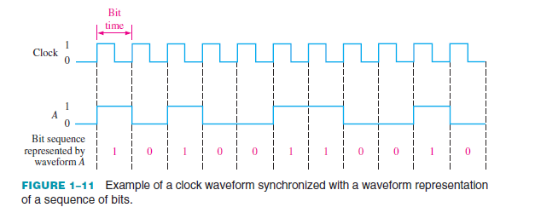
A Digital Waveform Carries Binary Information
The Clock

Slide 44
A Digital Waveform Carries Binary Information
Timing Diagrams
A timing diagram
is a graph of digital waveforms showing the actual time relationship of two or more waveforms and how each waveform changes in relation to the others.
can determine the states (HIGH or LOW) of all the waveforms at any specified point in time and the exact time that a waveform changes state relative to the other waveforms
Figure 1–12 is an example of a timing diagram made up of four waveforms.
the three waveforms A, B, and C are HIGH only during bit time 7 (shaded area) and they all change back LOW at the end of bit time 7.

Slide 45
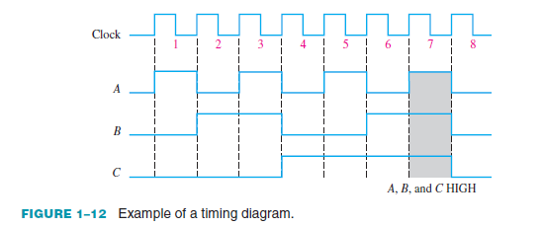
A Digital Waveform Carries Binary Information
Timing Diagrams

Slide 46
A Digital Waveform Carries Binary Information
Data Transfer
Data
refers to groups of bits that convey some type of information.
Binary data
represented by digital waveforms
ransferred from one device to another
As illustrated in Figure 1–13,
binary data are transferred in two ways: serial and parallel.
Serial
sent one bit at a time along a single line During the time interval from t0 to t1, the first bit is transferred.
During the time interval from t1 to t2, the second bit is transferred, and so on.
To transfer eight bits in series, it takes eight time-intervals.

Slide 47
A Digital Waveform Carries Binary Information
Data Transfer
parallel
When bits are transferred in parallel form, all the bits in a group are sent out on separate lines at the same time.
There is one line for each bit as shown in Figure 1–13(b)
To transfer eight bits in parallel, it takes one time interval compared to eight time intervals for the serial transfer.
an advantage
of serial transfer of binary data is that a minimum of only one line is required.
In parallel transfer, a number of lines equal to the number of bits to be transferred at one time is required.
A disadvantage
of serial transfer is that it takes longer to transfer a given number of bits than with parallel transfer at the same clock frequency
parallel transfer takes more lines than serial transfer.

Slide 48
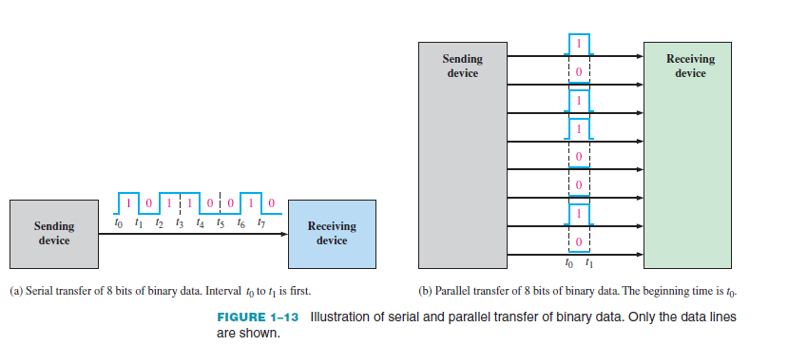
A Digital Waveform Carries Binary Information
Data Transfer

Slide 49
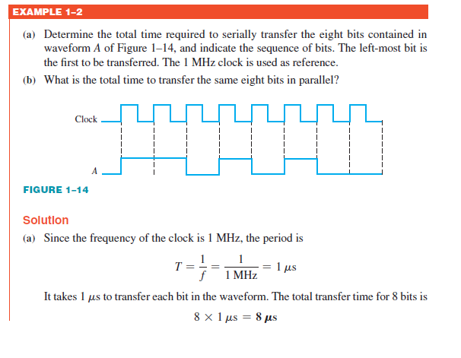
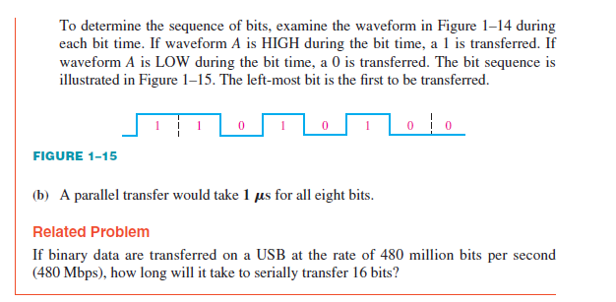
A Digital Waveform Carries Binary Information

Slide 50
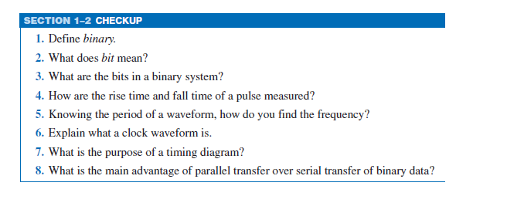
A Digital Waveform Carries Binary Information

Slide 51
1–3 Basic Logic Functions
logic is the realm of human reasoning
that tells you a certain proposition (declarative statement)
is true if certain conditions are true.
Propositions can be classified as true or false.
Yes or no
Several propositions, when combined
form propositional, or logic, functions.
For example, the propositional statement
“The light is on” will be true if “The bulb is not burned out” is true and if “The switch is on” is true.
Therefore, this logical statement can be made: The light is on only if the bulb is not burned out and the switch is on.
In this example the first statement is true only if the last two statements are true.
The first statement (“The light is on”) is then the basic proposition
the other two statements are the conditions on which the proposition depends.

